Slide 1
R3M: ACO
Robert Yerex, Ph.D. Senior Data Scientist Accountable Care Organization 05/11/2016

Slide 2
Executive Summary
Objectives. To develop a software application to assist ACO Care Coordinators in prioritizing intervention efforts allocated to ACO patients discharged within the previous 30 days.
Data Sources.
Patient History: Derived from the Claim and Claim Line Feed (CCLF) files provided by the Centers for Medicare & Medicaid Services (CMS).
Majority of important features are based on reconstituting patient history from the ACO claims.
Current Inpatient Episode: Epic EMR
Includes some additional features (i.e. smoking behavior)
Technology. A predictive model based on statistical learning techniques used to predict a patient’s hazard function across the first 30 days post discharge.
Performance. Accuracy (% of 30 day readmissions detected) > 88% when cutoff set at twice prevalence (28%)

Slide 3
Use Case
Large Case Load:
Between January 2013 and April 2016, the number of ACO patients discharged from UVA within the previous 30 days averaged 183; of whom 25 would experience an unplanned readmission (to UVA), within 30 days of their discharge.
Application:
Provide a list of ACO patients discharged over the previous 30 days in ranked relative order of likelihood of being readmitted less than 30 days post discharge.
Post discharge follow-up intervention reduced utilization by 8.3% ¹
42 minutes per patient
¹ Jack, B. W. et al. A Reengineered Hospital Discharge Program to Decrease Rehospitalization. Ann Intern Med 150, 178–187 (2009).

Slide 4
State of the Art
Domain:
Models to predict 30 day readmission in the US, using retrospective administration data such as CMS Claims Data Feed
Results:
Nine large population-based or multicenter US studies had c-statistics 0.55 – 0.65¹
Models developed by CMS for congestive heart failure, acute myocardial infarction, and pneumonia had c-statistics of 0.61, 0.63, and 0.63, respectively
Human expert based protocols fared even worse with AUC statistics from 0.50 for case managers to 0.59 for interns, 0.56 for Physicians ².
¹ Kansagara, D. et al. Risk Prediction Models for Hospital Readmission: A Systematic Review. (Department of Veterans Affairs (US), 2011). at http://www.ncbi.nlm.nih.gov/books/NBK82578/
² Allaudeen, N., Schnipper, J. L., Orav, E. J., Wachter, R. M. & Vidyarthi, A. R. Inability of Providers to Predict Unplanned Readmissions. J Gen Intern Med 26, 771–776 (2011).

Slide 5
Limiting Factors
Data:
Modeling methodology:
Feature engineering:
Target
Delivery mechanism

Slide 6
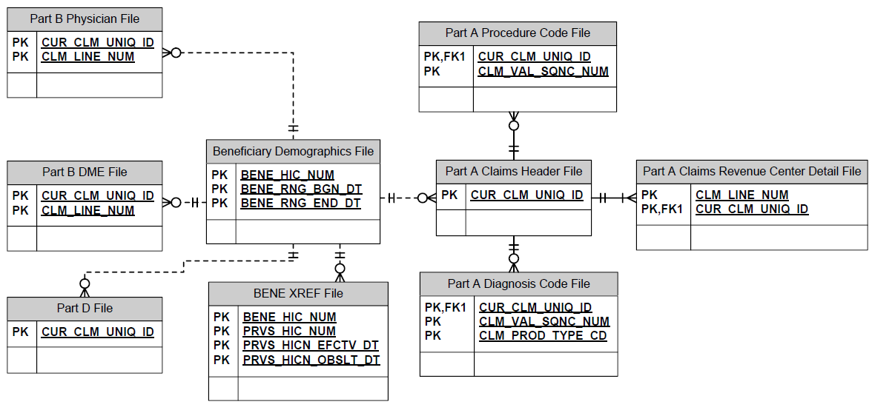
Data – CMS Claims Data Files

Slide 7
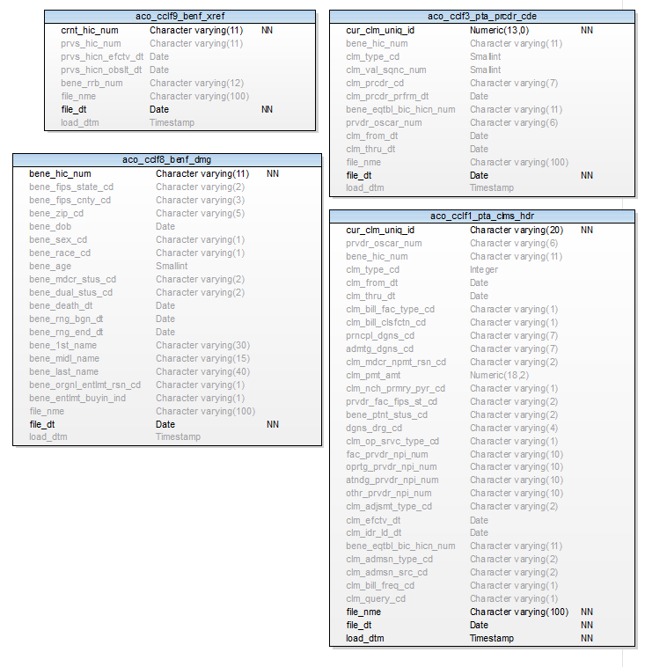
ACO Claims Schema

Slide 8
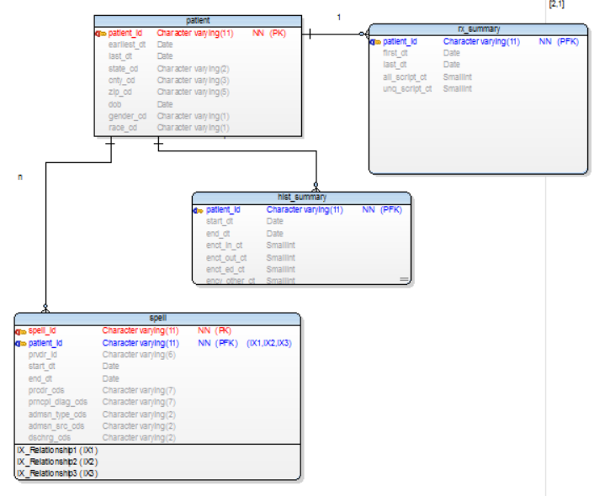
Data – Medical History View

Slide 9
Modeling
Trade off between predictive accuracy and model interpretability
Algorithmic / Statistical Learning based models are more accurate, less interpretable
Interpretability
Predictive Accuracy
Human Expert Logistic Regression Random Forest SVN NN

Slide 10
Feature Engineering
Basic Features:
Demographics, utilization, diagnostic history
Additional Features:
Socioeconomic (median income, education), accessibility of care (distance to PCP, density of care facilities/practitioners)
Engineered Features:
Dimensionality reduction (combinations of ICD codes)
Directed graph model

Slide 11
Combining ICD Codes
Defined indices:
Charlson Comorbidity Index
Lacks temporal information
Simple:
Combinations / Permutations
Directed graph:

Slide 12

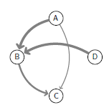
Medical Event Sequence

Slide 13
Target
Survival / Hazard Models:
Generate a predicted hazard rate by post discharge day.
Calculate cumulative remaining hazard
where
and

Slide 14
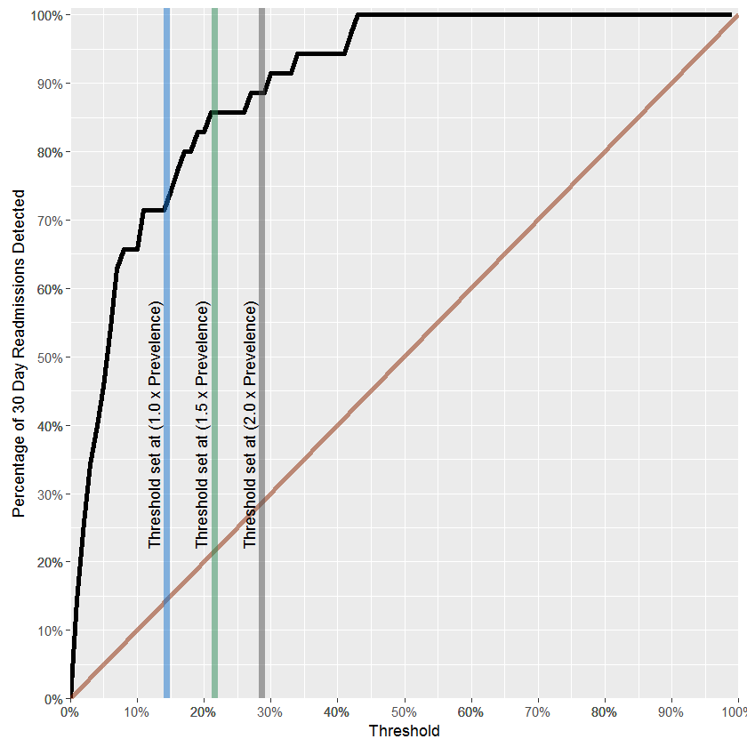
Results: Silent Test

